Slide 1
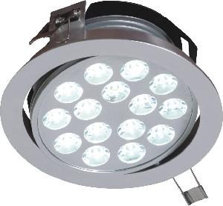
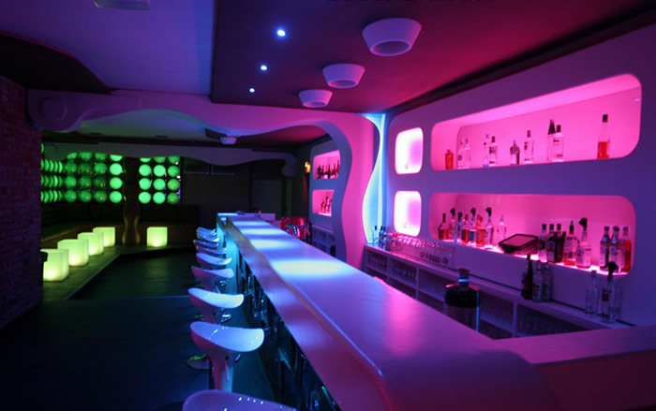
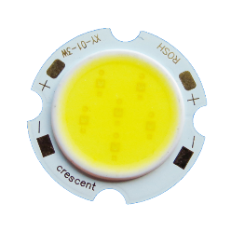
ETP
Power LEDs for Lighting

Slide 2
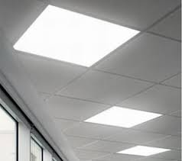
What are LED Lighting Applications?
LED lighting technology is also known as Solid State Lighting (SSL)
LEDs are used to illuminate a room, a surface or object … → i.e. LEDs are not used as signal lights
No direct view between “user” and the light source. Lamp shades or diffusers are used. (see next slide)
Most lighting applications require white LEDs
Power LEDs are required, e.g. P > 0.5W

Slide 3
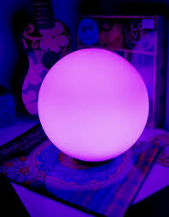
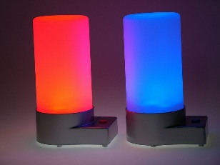
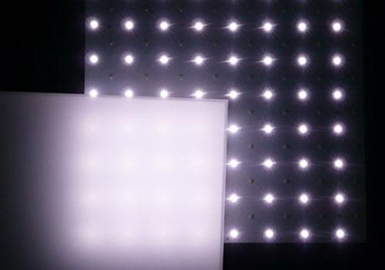

Lamp Shade / Diffuser
Lamp shades are used to
To prevent dazzling due to direct view between the “user” and the light source. Reasons: Eye safety (see separate presentation) and user comfort.
To allow adding different colored light sources to the resulting “Moodlight color”.
To distribute the light evenly, prevent “hot spots”.
A light diffuser may be used alternatively e.g. milky glass (aka “opal glass”, paper, specific light diffuser films …
The ETP Moodlight needs also a lamp shade or a diffuser → You’re invited to already think up some good ideas for your individual Moodlight.

Slide 4

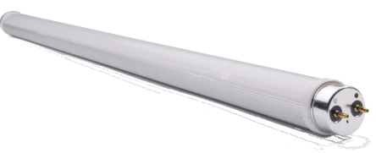


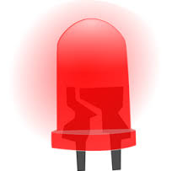
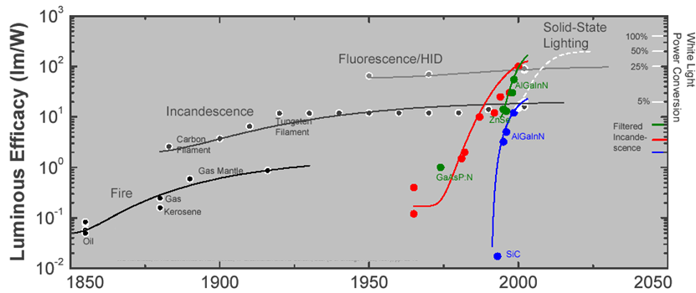
Evolution of Lighting Technologies
Source: energy.sandia.gov
HID = High Intensity Discharge

Slide 5
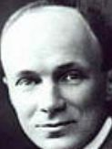

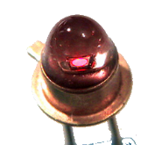
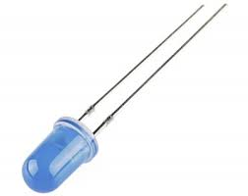
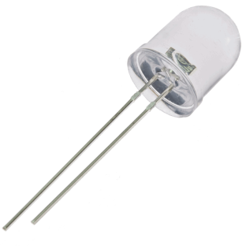
The History of LED Technology
1907: Henry Joseph Round observed light emission when a current flows through a crystal detector (diode)
1929: First patent for a LED granted to the Russian scientist and inventor Oleg Losev.
No commercial use of LED technology until early 1960s
1961: Modern LED invented at Texas Instruments
Since 1970’s: LEDs used as indicator lights
Since 1993: Blue LEDs
Since 1995: White LEDs
Notes:
About Losev: In the mid 1920’s the Russian scientist and inventor Oleg Vladimirovich Losev observed emission of light e.g. from silicon carbide crystal rectifier diodes that were used in radio receivers when current was passed through them. He furthermore showed that the produced light is kind of a “cold” light. These effectively constituted the discovery of what we now know as the the LED

Slide 6
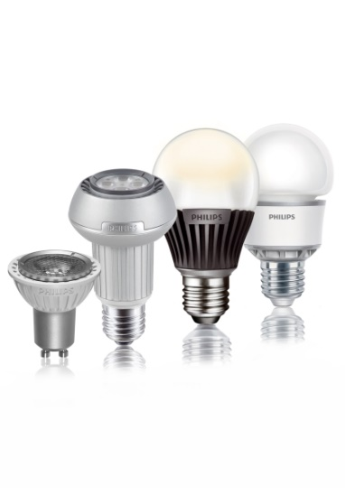

The History of LED Technology
Since 2005: White Power LEDs for lighting applications.
Since 2010: Mass production of LED lighting products. LED replacement for “good old” incandescent light bulbs.
2019 .. future: Ongoing research for better efficacy and usability, lower cost .. → materials, organic LEDs, driving circuits …
Notes:
About Losev: In the mid 1920’s the Russian scientist and inventor Oleg Vladimirovich Losev observed emission of light e.g. from silicon carbide crystal rectifier diodes that were used in radio receivers when current was passed through them. He furthermore showed that the produced light is kind of cold light. These effectively constituted the discovery of what we now know as the the LED

Slide 7
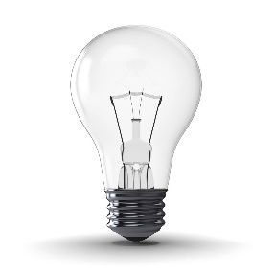
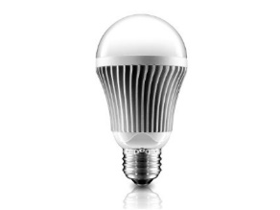
LED Lighting Applications
Indoor Lighting
Retrofit LED replacement lamps:
LED luminaires:
Moodlight illuminations:

Slide 8
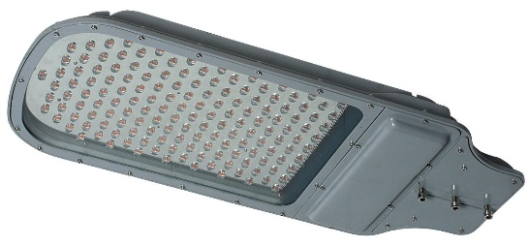
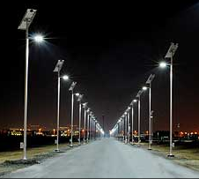
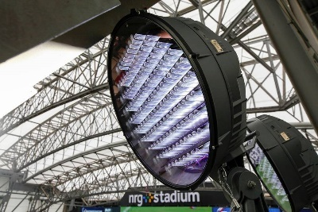
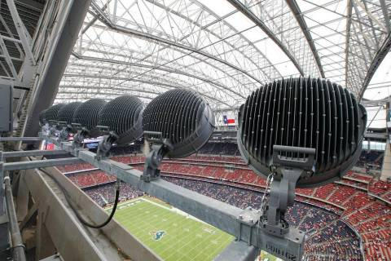
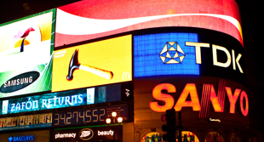
LED Lighting Applications
Outdoor Lighting
Street lights:
Sports Stadium Lights:
Illuminated Advertising:

Slide 9
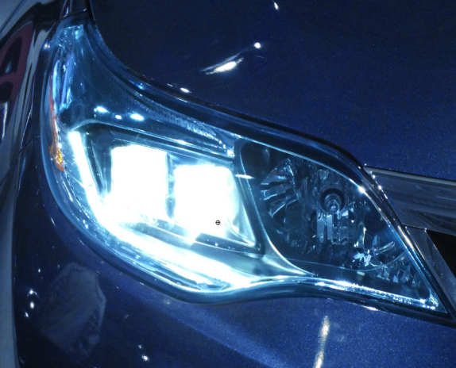
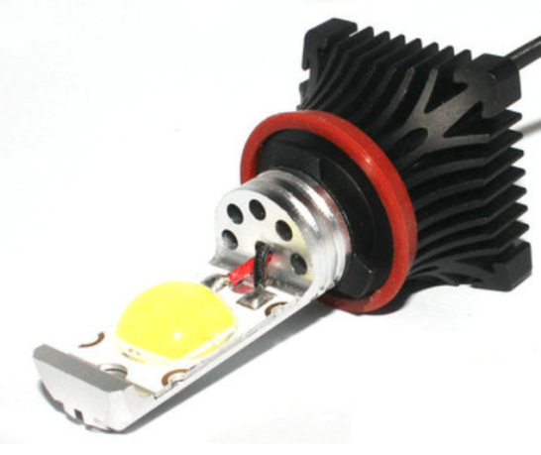
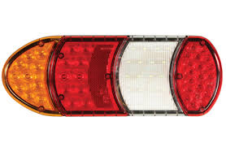
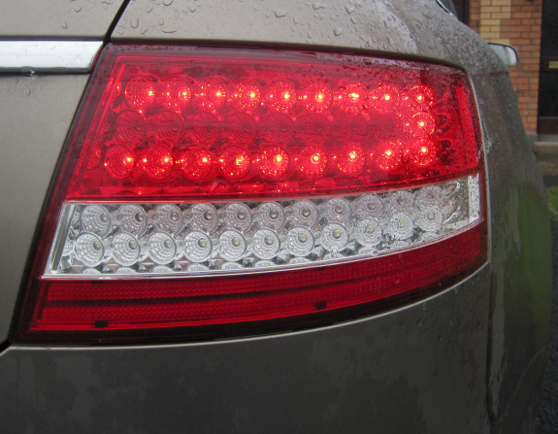
LED Lighting Applications
Automotive Lighting

Slide 10

What are the Benefits of LED Lighting ?
High efficiency → energy savings
Longer lifetimes → cost savings, better reliability
Mechanical robustness → Well suited for mobile applications
White LEDs and colored LEDs available → e.g. for Moodlights
Fast response → No warm-up times
Dimmable, easy to control
…

Slide 11
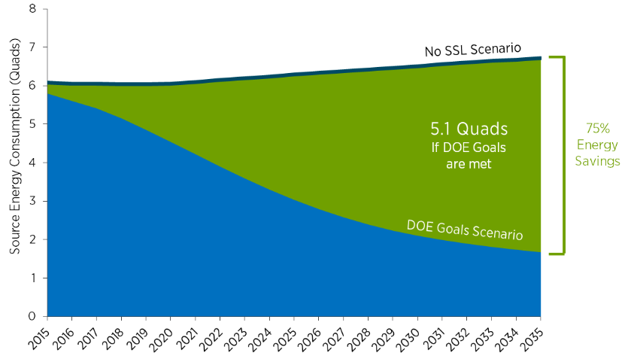
Energy Savings Forecast
with LED Lighting (in the USA)
1quad ≈ 10¹⁸ Joule or 293 10⁹ kWh
DOE = US Department Of Energy
Source: U.S. Department of Energy (DOE), Energy Savings Forecast of SSLLighting in General Illumination Applications

Slide 12
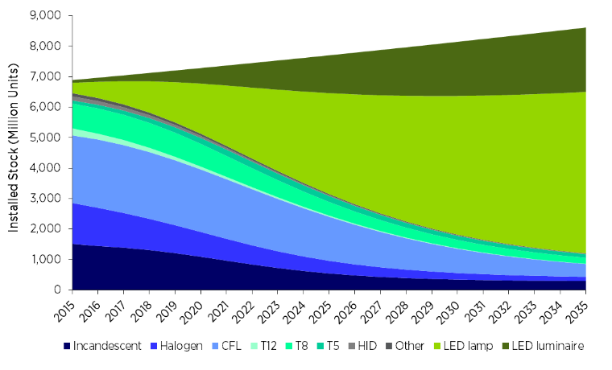
Forecast for Lighting Technologies
US Lighting Service Forecast 2015 .. 2030
HID = High Intensity Discharge, CFL = Compact Fluorescent, T12/T8/T5 = Flourescent Lamps
Source: U.S. Department of Energy (DOE), Energy Savings Forecast of SSLLighting in General Illumination Applications

Slide 13
How LEDs work
A LED (Light Emitting Diode) is a semiconductor diode which is able to emit light from its PN junction.
LED symbol:
PN Junction:

Slide 14
How LEDs work
Recombination of holes and electrons at the PN junction emits light.

Slide 15
How LEDs work
Bandgap model shows:
Due to recombination, electrons fall into a lower energy band. The difference of energy (bandgap energy E_{G}) is released in form of a photon (equivalent to emission of light).

Slide 16
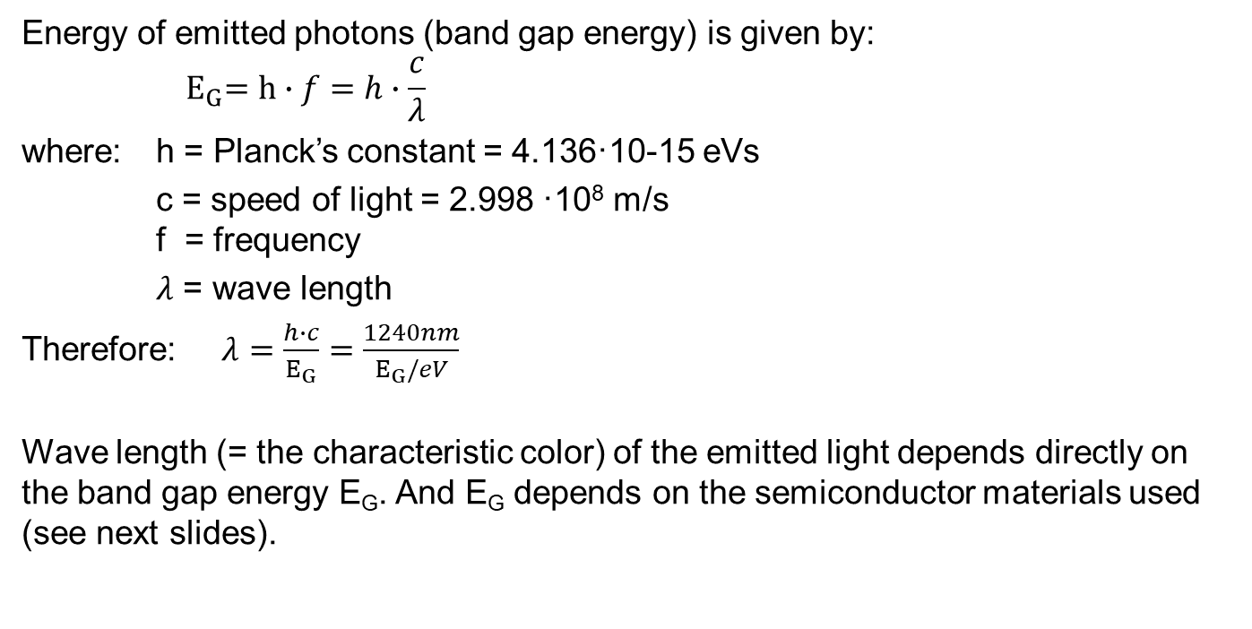
How LEDs work
Energy of emitted photons (band gap energy) is given by: $${ E}_{G}=h∙f=h∙\frac{c}{λ}$$
where: h = Planck’s constant = 4.136·10-15 eVs
c = speed of light = 2.998 ·10⁸ m/s f = frequency
$λ$ = wave length
Therefore:$λ=\frac{h∙c}{E_{G}}=\frac{1240nm}{E_{G}/eV}$
Wave length (= the characteristic color) of the emitted light depends directly on the band gap energy E_{G}. And E_{G} depends on the semiconductor materials used (see next slides).
The color of an LED depends on materials used.

Slide 17
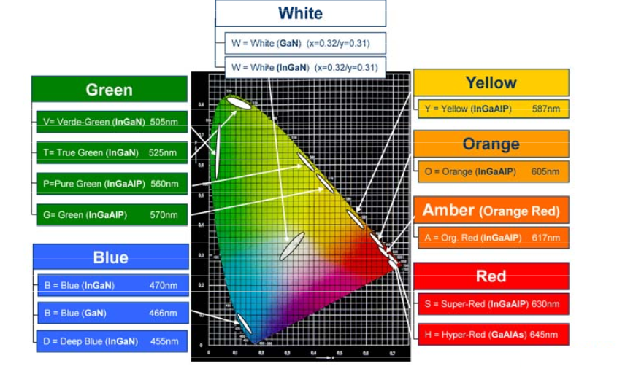
Example of LED Color Portfolio
Source: Osram Opto Semiconductors

Slide 18
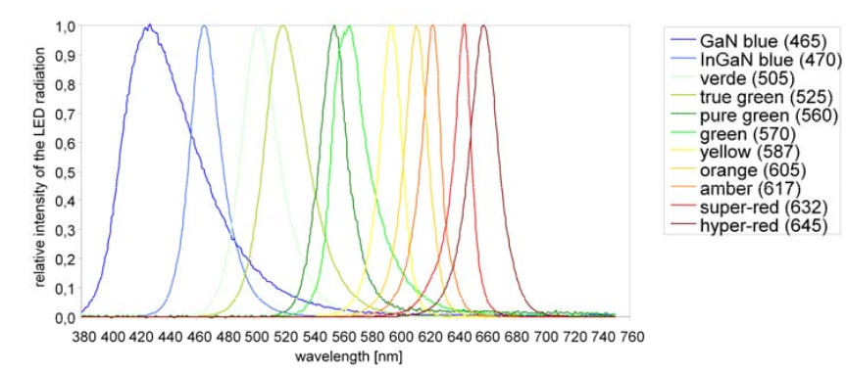
Example of LED Color Portfolio
Example of a LED Color Portfolio
Source: Osram Opto Semiconductors

Slide 19
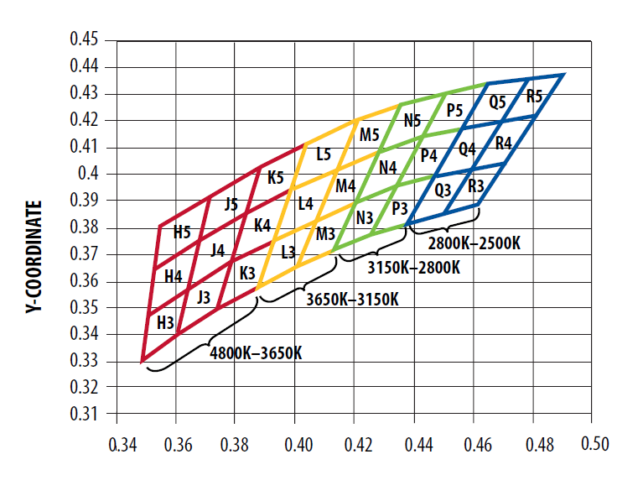
LED Binning
Some important LED parameters (e.g. color, luminous flux, forward voltage …), may significantly vary during production, even for LEDs from the same production batch.
These parameters are therefore measured during production and the LEDs are assigned to different finely graded subclasses (“bins”).
Process of segregating LEDs is called “binning”
Binning is essential for most LED lighting applications. E.g. it allows that the luminaires used to illuminate a room have no visible differences.
Source: www.avagotech.com

Slide 20
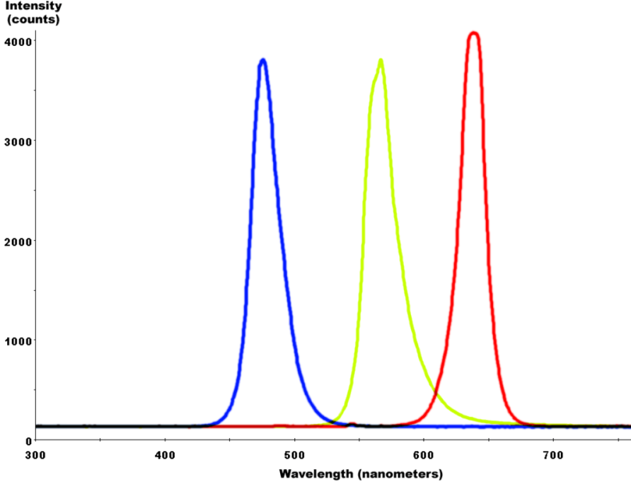
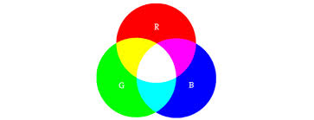
White LEDs
LEDs cannot directly emit white light, following two indirect approaches are widely used
1st approach: Additive color mixing Mix (add) multiple colors (e.g. red, green , blue) to white light, color can be adjusted with intensity of each generated color (e.g. used in Moodlight)

Slide 21
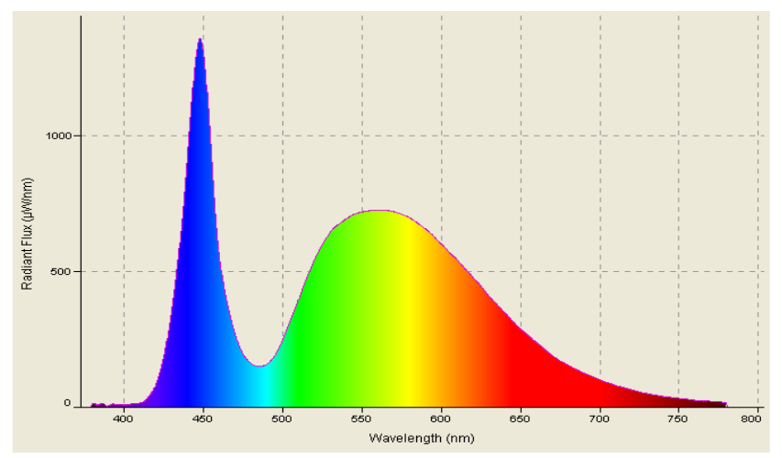
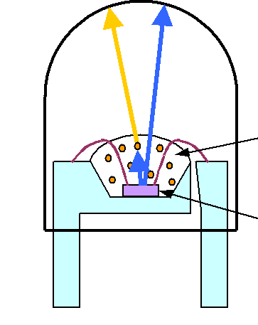
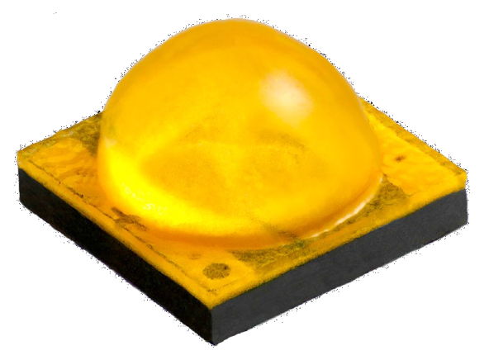
White LEDs
2nd approach: Make use of phosphorescence effect: Convert blue light into white light, with a blue LED and a phosphor layer (or a phosphor coating) adding original blue and converted amber colored light results in white light. Used by most LED lighting applications today
original blue LED
converted by phosphorescence
Phosphor layer
Blue LED chip

Slide 22
Electrical Characteristics of LEDs
Electrical LED characteristics are basically the same as the characteristics of standard diode.
LED illuminates only when operated in the forward mode, i.e. when a high enough current flows.

Slide 23
LED Electrical Characteristics
Forward voltage characteristics depend on the LED color: The lower the wavelength, the higher the forward threshold voltage (as a consequence of different band gap energies)

Slide 24
LED Electrical Characteristics
The forward voltage V_{f} has a relatively high production spread
LEDs cannot be directly driven with a constant voltage source
for accurate results, LEDs should be driven by a constant current source

Slide 25
Structure of a Power LED
Power LEDs are always surface mounted

Slide 26
Thermal Management of Power LEDs
For power LEDs: more than 70% of the consumed electrical power is converted into heat by the LED’s PN junction.
Thermal management is important to assure that the junction temperature does not exceed a certain limit.
For an optimal life time of the LED, its junction temperature should not exceed 120°C.
The possible methods to remove heat are
conduction,
convection
and radiation
all of them should be considered for power management

Slide 27
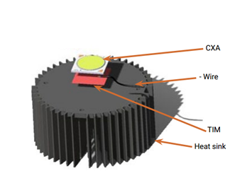
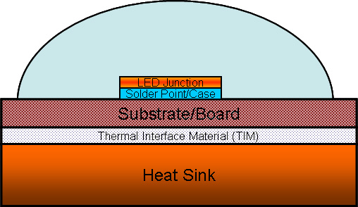
Thermal Management of Power LEDs
Since the transparent front side of the LED is a very poor heat conductor, nearly all heat produced is conducted over the LED’s backside.
The heat flows from the junction through the solder points to the substrate board (i.e. the PCB) and further to the heatsink
A heatsink dissipates the heat through convection and radiation.

Slide 28
Thermal Management of Power LEDs
The thermal model of a LED has a behavior which is similar to a simple electrical equivalent circuit:

Slide 29
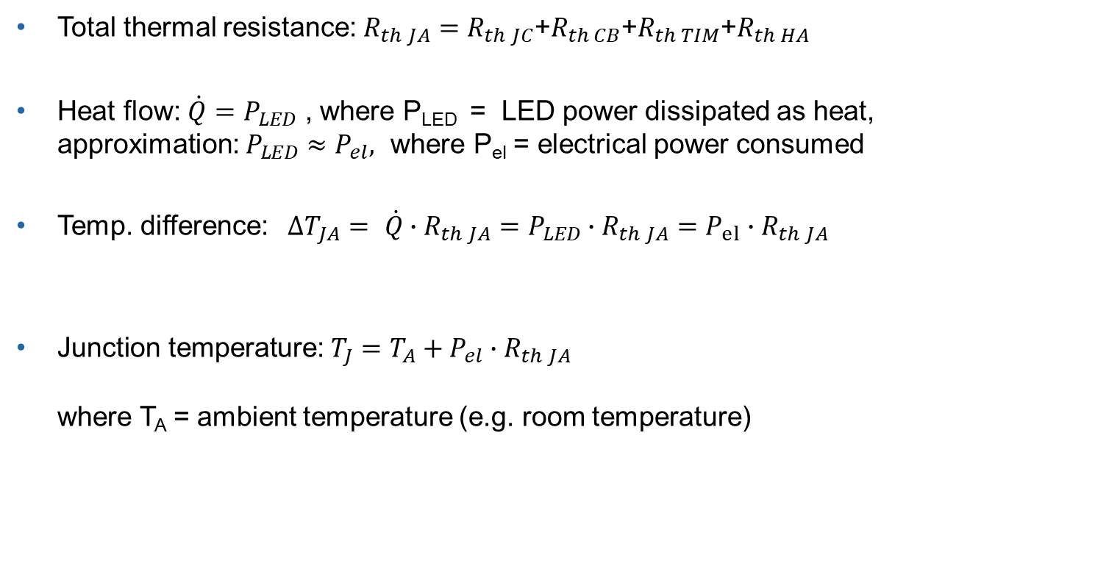
Thermal Management of Power LEDs
Total thermal resistance:$R_{th JA}=R_{th JC}$+$R_{th CB}$+$R_{th TIM}$+$R_{th HA}$
Heat flow: $\dot{Q}=P_{LED}$ , where P_{LED} = LED power dissipated as heat, approximation: $P_{LED}≈P_{el},$ where P_{el} = electrical power consumed
Temp. difference:$ΔT_{JA}= \dot{Q}∙R_{th JA}=P_{LED}∙R_{th JA}=P_{el}∙R_{th JA}$
$\text{Junction} \text{temperature}\text{:} T_{J}=T_{A}+P_{el}{∙R}_{th JA}$ where T_{A} = ambient temperature (e.g. room temperature)

Slide 30
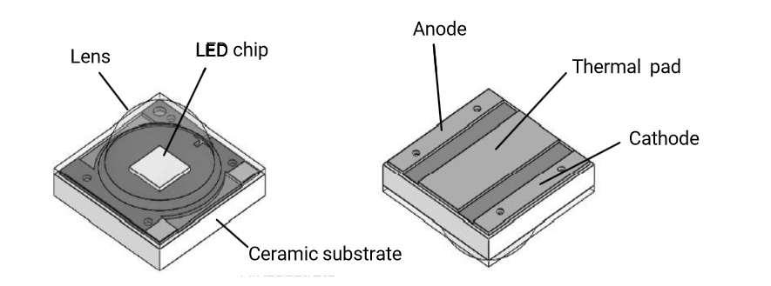
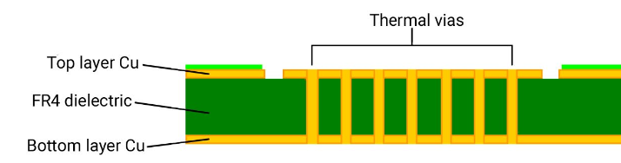
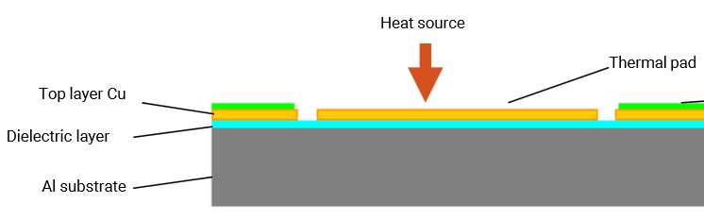
Thermal Management of Power LEDs Measures to Reduce R_{th}
Best practice to reduce R_{thCB} :
Always solder the LEDs thermal pad (if there is any)
use PCB copper area as much as possible for heat conduction
use thermal vias below thermal pad zone to conduct heat to bottom layer
or use special metal-core PCB (MCPCB)

Slide 31
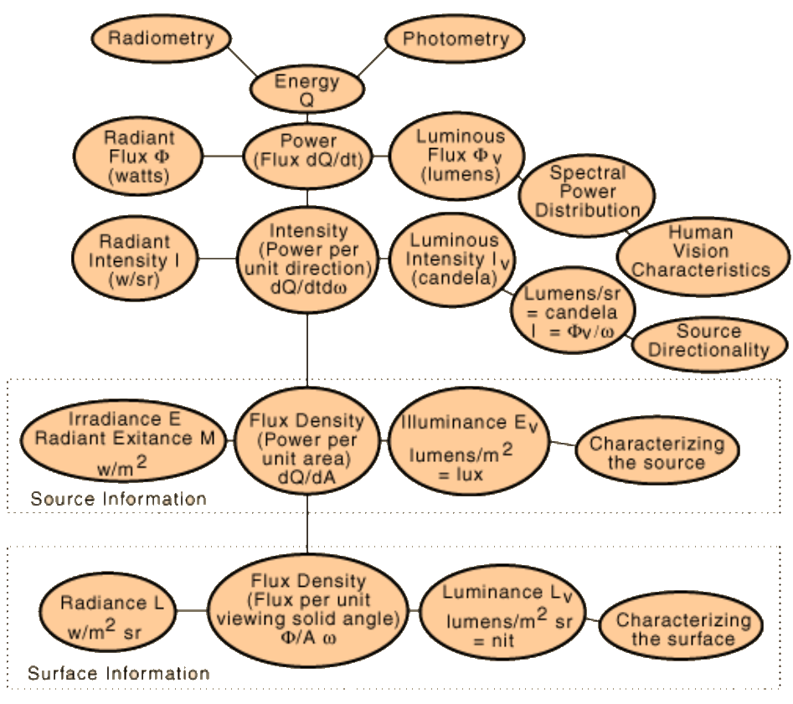
Photometric Quantities for LED Characterization
Photometry
Source: http://hyperphysics.phy-astr.gsu.edu

Slide 32
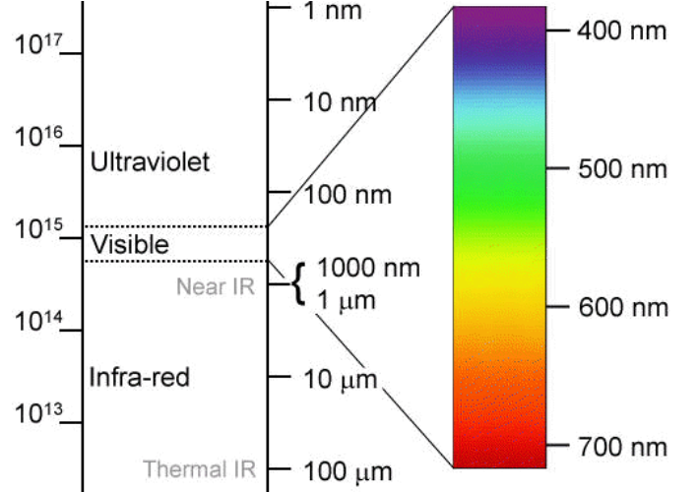
Photometry vs. Radiometry
Radiometry deals with any “light” radiation in the spectrum (visible or invisible light).
It covers thus, ultra-violet, visible light and infra-red Note: infra-red includes also heat radiation

Slide 33
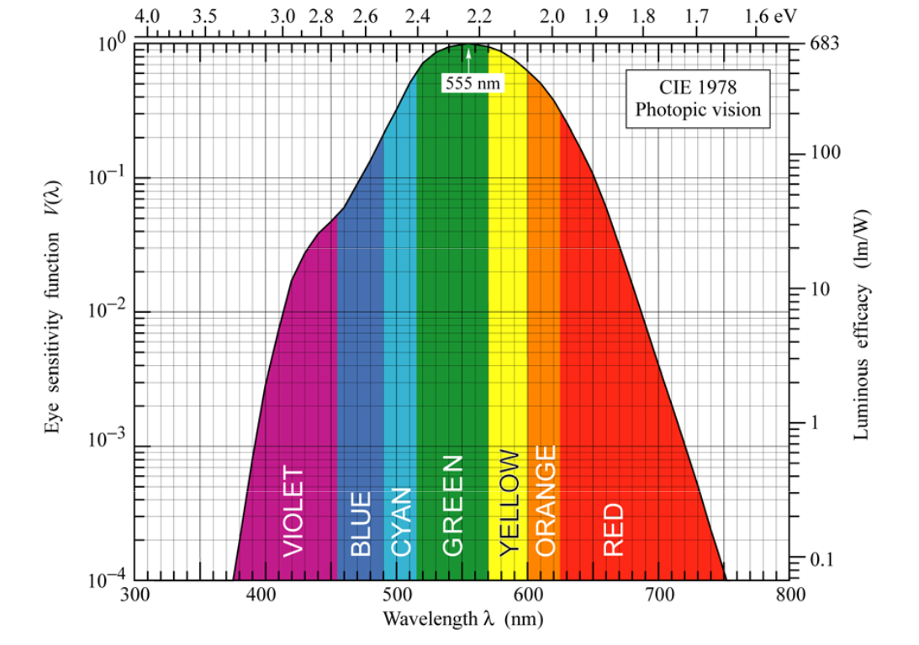
Photometry vs. Radiometry
Photometry restricts its scope to visible light
For all photometric quantities, the radiation intensity is weighted with the human eye’s spectral sensitivity function V( λ )
Standard eye sensitivity functions are defined: - Phototopic curve is applicable to daylight vision, - Scotopic curve to night vision)
Source: www.ecse.rpi.edu

Slide 34
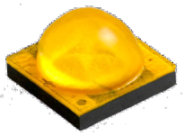
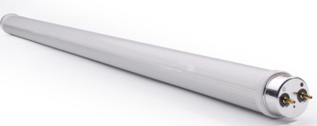
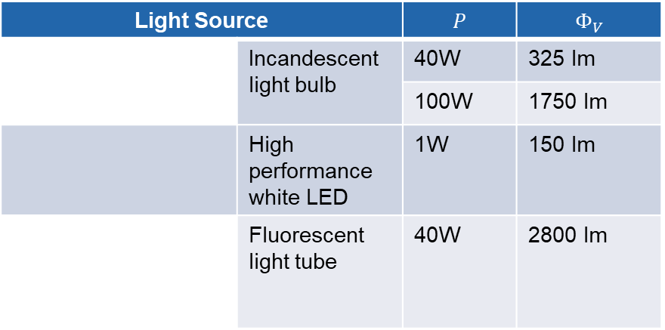
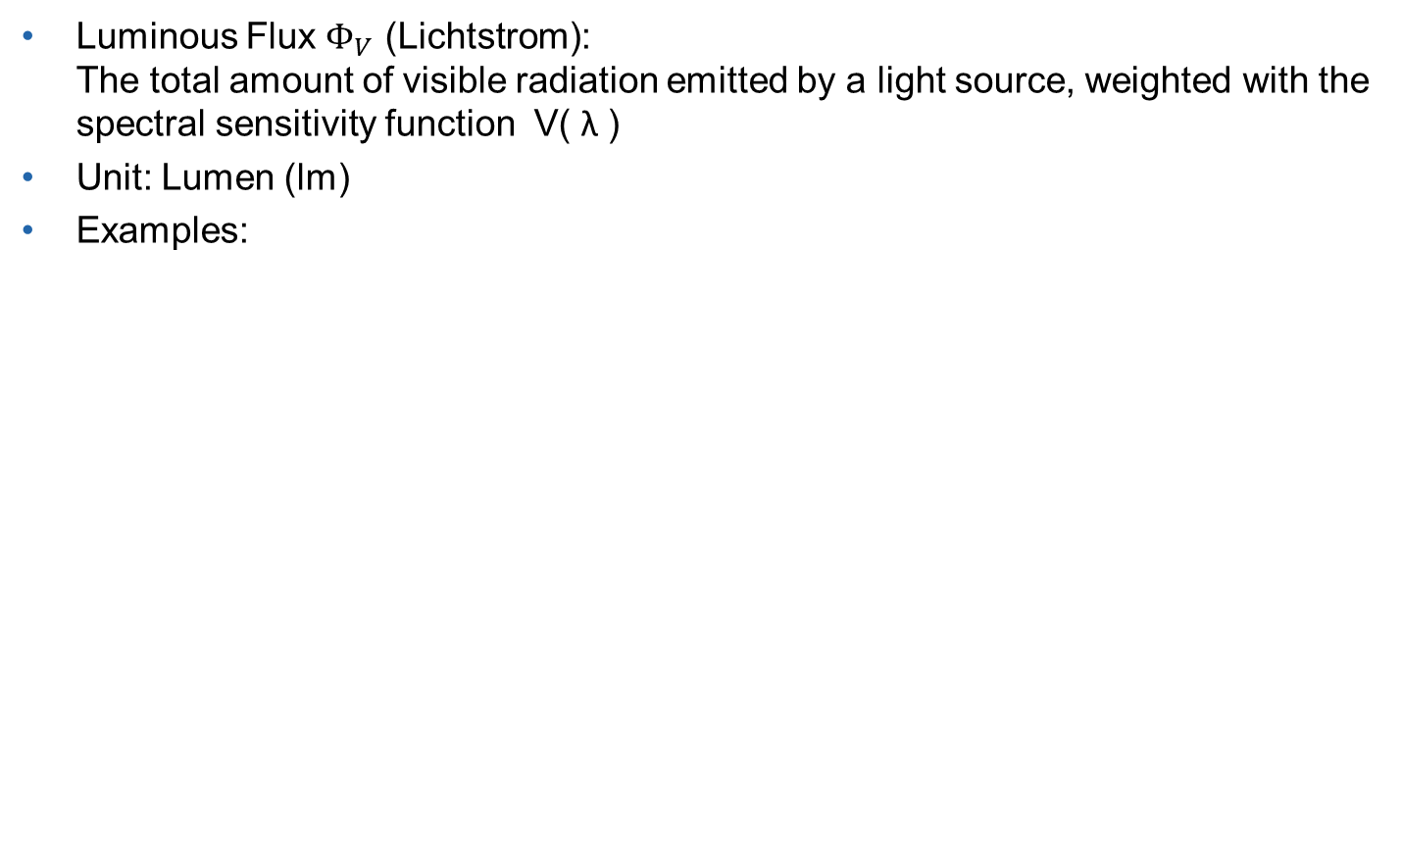
Photometric Quantities: Luminous Flux
Luminous Flux $Φ_{V}$ (Lichtstrom): The total amount of visible radiation emitted by a light source, weighted with the spectral sensitivity function V( λ )
Unit: Lumen (lm)
Examples:
Light Source |  | $$P$$ | $$Φ_{V}$$
 | Incandescent light bulb | 40W | 325 lm
 |  | 100W | 1750 lm
 | High performance white LED | 1W | 150 lm
 | Fluorescent light tube | 40W | 2800 lm

Slide 35



Luminous Efficacy, Efficiency
Luminous Efficacy (Lichtausbeute): Luminous Flux per Watt consumed $\text{Luminous} \text{Efficacy}= \frac{Φ_{v}}{P_{el}}$
Efficiency η (Wirkungsgrad): Radiated Power of visible light per Watt consumed $η= \frac{P_{light }}{P_{el}}$
Examples:
Light Source | $$P$$ | Efficacy | Efficiency
 | 40 W | 8 lm/W | 1%
 | 100W | 17 lm / W | 2%
 | 1W | 150 lm/W | 20%
 | 40W | 80 lm/W | 10%

Slide 36


Photometric Quantities: Luminous Intensity
Luminous Intensity (Lichtstärke) I_{v}: Intensity of light emitted in a certain direction Luminous flux per unit of a solid angle (steradian)
$Iv=\frac{Φ_{v}}{Ω}$ where: Ω = solid angle: $Ω=\frac{A}{r^{2}}$ → constant I_{v} assumed within regarded solid angle
Unit: Candela (cd) → this is the photometric SI base unit

Slide 37




Photometric Quantities: Luminous Intensity
Estimation of $Ω$for LED characterization: Solid angle $Ω≈2π\left(1−cos\left(θ_{1/2}\right)\right)$ Where: ${2θ}_{1/2}$ = LED viewing angle at which I_{v} = $\frac{I_{v max}}{2}$ Assumption, simplification: Complete $Φ_{v}$is radiated within $Ω ($with constant I_{v} ) and nothing is radiated outside $Ω$.
Examples of typical values for luminous Intensity I_{v}:
Light Source | I_{v}
Candle | 1 cd
Incandescent light bulb 100W | 140 cd
Standard Signal LED @ I_{F}=10mA | 0.02 cd
High performance white LED, 1W, $2$ $θ_{1/2}$= 115° | 50 cd

Slide 38

LED Viewing Angle
The directional light emission characteristic is often expressed with the viewing angle 2${ Θ}_{1/2}$
2${ Θ}_{1/2}$is the FWHM value (“Full Width at Half Maximum”) I.e. the angle between the two points (and the light source) at which the luminous intensity is half of the maximum value.

Slide 39


Photometric Quantities: Luminance
Luminance L_{V} (Leuchtdichte): Luminance is a measure for the strength of light seen (how glaring it is) when directly looking at the light source. When looking at the radiating surface with an angle normal to that surface: L_{V} $= \frac{I_{v}}{A}$ Where A is the radiating area seen. For LEDs : the area of the lens (i.e. not of the LED die).
Unit: cd / m²
Luminance describes how the light source is seen by the human eye.

Slide 40
Photometric Quantities: Luminance
Examples
Light Source | L_{v}
Incandescent light bulb 100W, transparent glass body | 2·10⁶ cd / m²
Incandescent light bulb 100W, matt glass body | 200·10³ cd / m²
Standard 3mm signal LED @ I_{F}=10mA | 30 cd /m²
High performance white LED, 1W, | 50·10³ cd / m²
Fluorescent tube, 40W | 2·10³ cd / m²
TFT notebook display, white screen | 100 cd / m²

Slide 41

Photometric Quantities: Illuminance
Illuminance E_{V} (Beleuchtungsstärke): Amount of light striking a surface. E_{V} $= \frac{I_{v}}{r^{2}} cos (ϵ)$ Unit : lux
Illuminance is important e.g. for planning the lighting of a room, of an office desk, a street etc.
Example:
Situation | E_{v}
Incandescent light bulb 100W, 1.2m, directly above office desk | 100 lux

Slide 42
Thank you,
for your attention !

